Slide 1
Group 5 King County Housing Project Prediction Of Home price
Presented By
Monika Singla

Slide 2
King County Housing Project
We gathered our data from public domain set available at Kaggle.
This data set is for King County WA. It includes all the expensive zip codes like Medina, Seattle, Redmond and Bellevue.
This data set is for the houses sold between May 2014- May 2015.

Slide 3
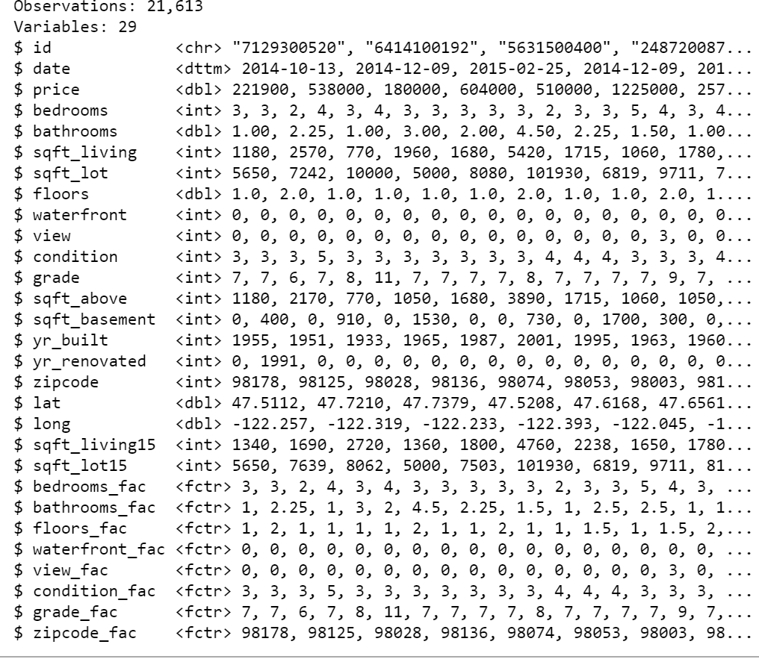
Closer look at the data

Slide 4
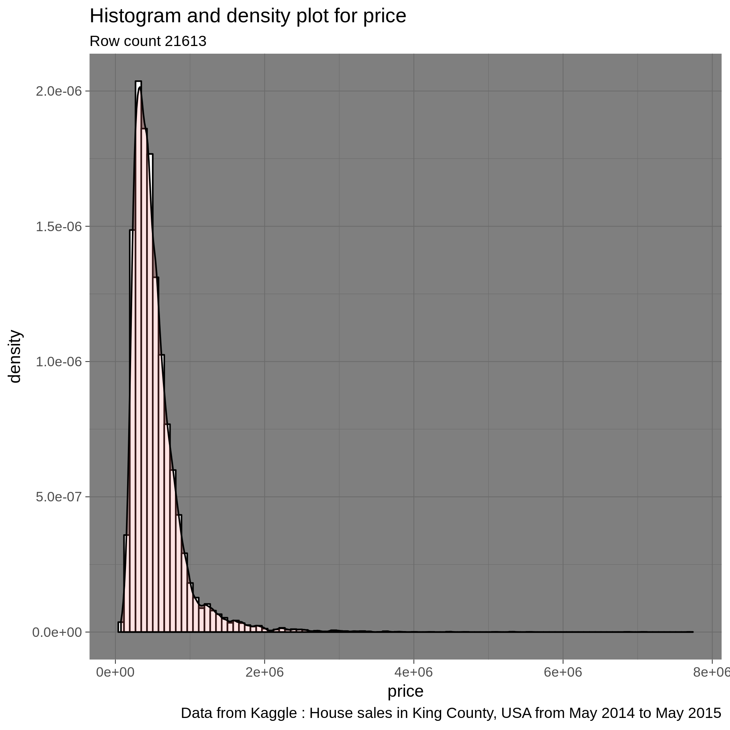
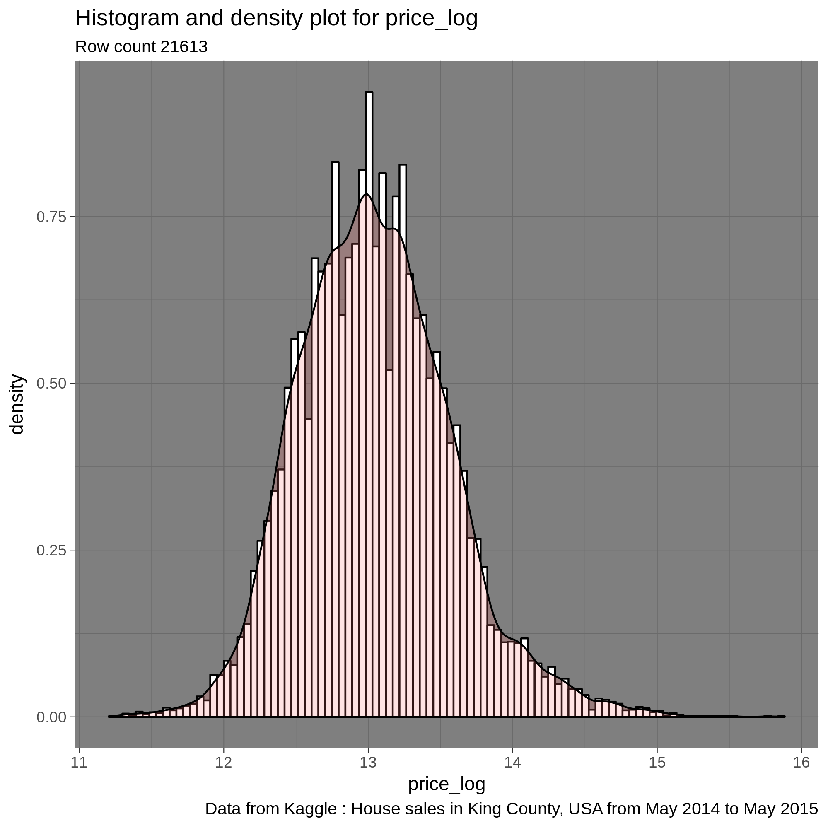
Gaussian distribution for log price is more symmetric

Slide 5
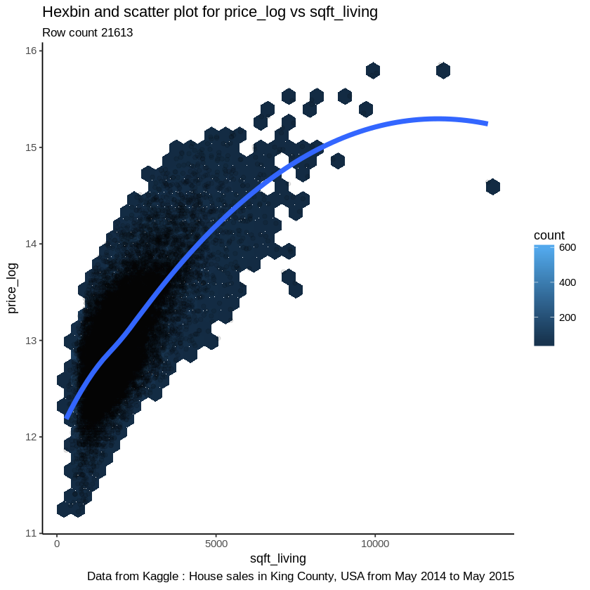
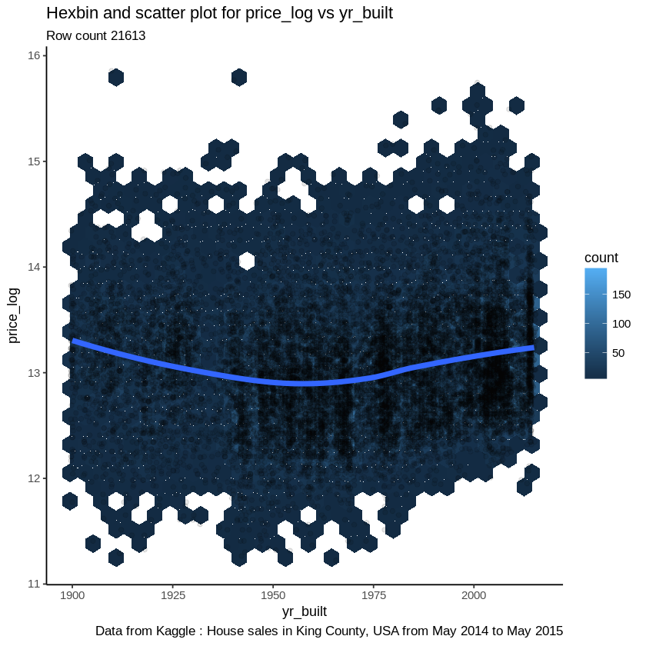
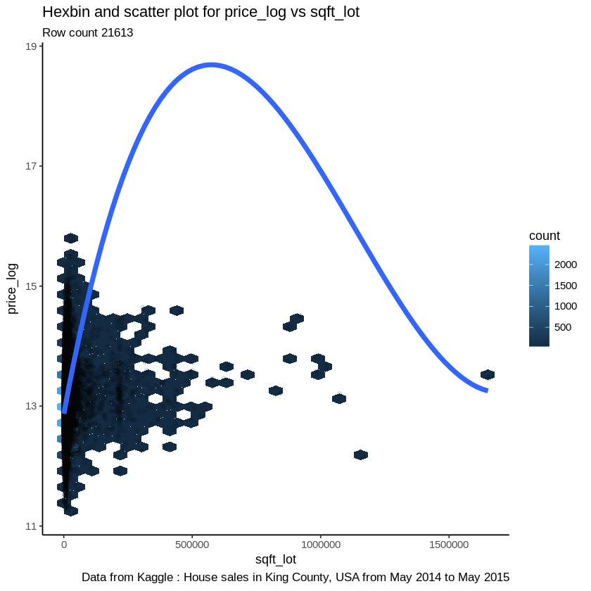
King County Housing Project Exploratory Data Analysis
price_log vs sqft_living
price_log vs sqft_lot
price_log vs yr_built

Slide 6
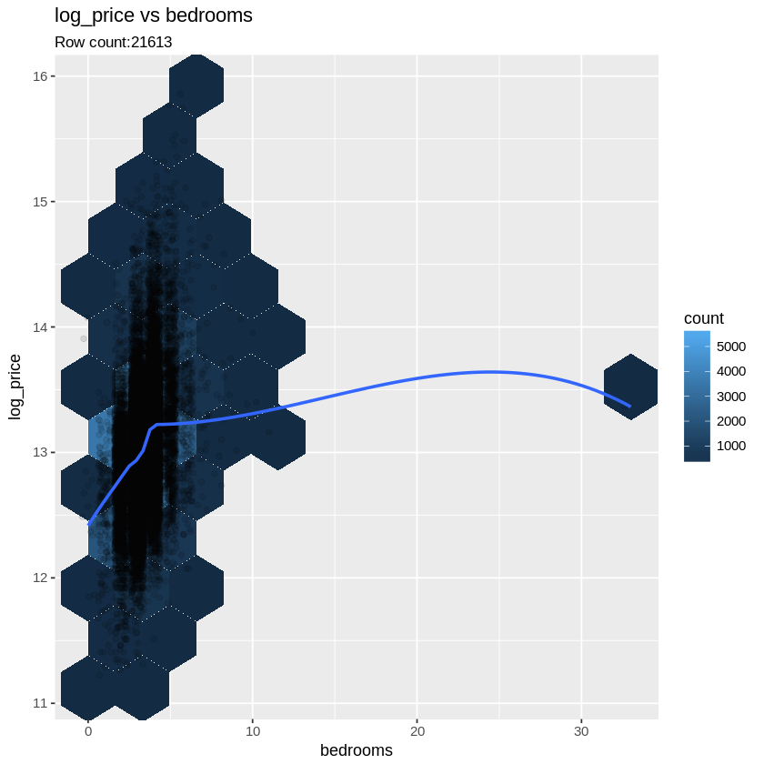
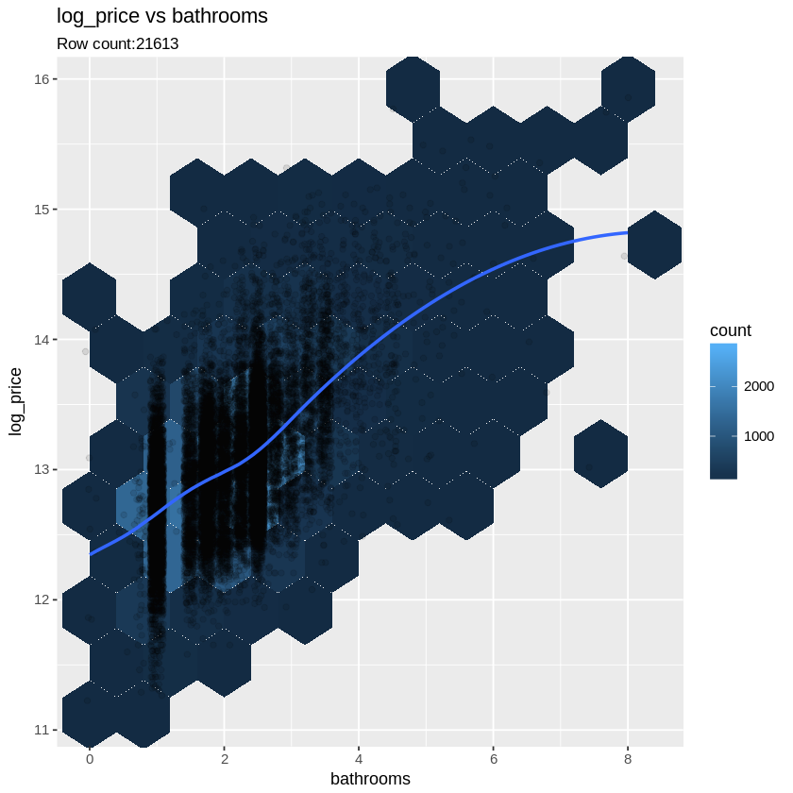
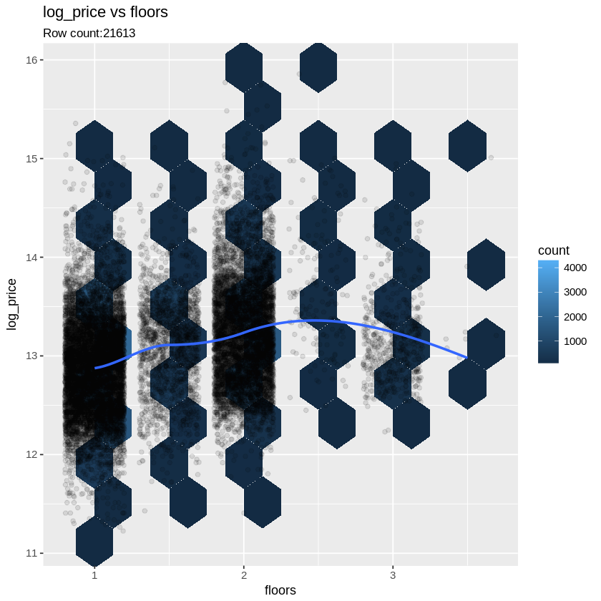
King County Housing Project
price_log vs bedrooms
log_price vs bathrooms
log_price vs floors

Slide 7
King County Housing Data Descriptive Statistics
Description | Mean | Maximum | Minimum
Price | 540088.1 | 7,700,000 | 75,000
Bedrooms | 3.370842 | 33 | 0
Bathrooms | 2.114757 | 8 | 0
Sqft_living | 2079.9 | 13540 | 290
Waterfront | 0.007541757 | 1 | 0

Slide 8
King County Housing Data
Most Significant Features
Square Feet Living
Waterfront
Zip code
Bedrooms
Bathrooms

Slide 9
WATERFRONT
T Value | P Value | Degree of Freedom | Mean of price for Waterfront homes | Mean of price for Waterfront homes
12.876 | 2.2e-16 | 162.23 | 1661876.0 | 531563.6
T Value | P Value | Degree of Freedom | Mean of Square feet Living for Waterfront homes | Mean of Square feet Living for Non Waterfront homes
8.7506 | 1.284e-15 | 162.78 | 3173.68 | 2071.588

Slide 10
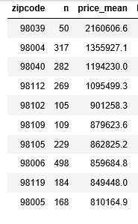
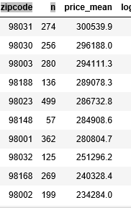
High Priced Zip code Zone:
Low Priced Zip Code Zone:

Slide 11
ZIPCODE
T Value | P value | Degree of Freedom | mean of High Priced Zip code bedrooms | mean of Low Priced Zip code bedrooms
2.5345 | 0.01254 | 12.865 | 3.639847 | 3.344046
Two Sample T Test Results for High Priced Area’s Bathrooms & Low Priced Area’s Bathrooms
T Value | P Value | Degree of Freedom | mean of High Priced Zip code bathrooms | mean of Low Priced Zip code bathrooms
4.4853 | 0.0001811 | 16.237 | 2.460109 | 1.906319 .

Slide 12
Two Sample T Test Results for High Priced Area’s Square Feet Living & Low Priced Area’s Square Feet Living
T Value | P Value | Degree of Freedom | mean of High Priced Zip code Square Feet Living | mean of Lo Low Priced Zip code Square Feet Living
4.3737 | 0.0005879 | 10.737 | 2623.131 | 1796.131

Slide 13
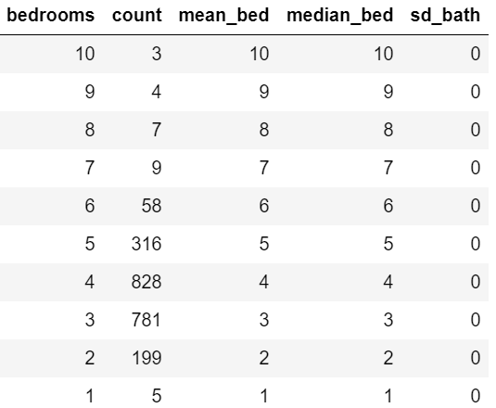
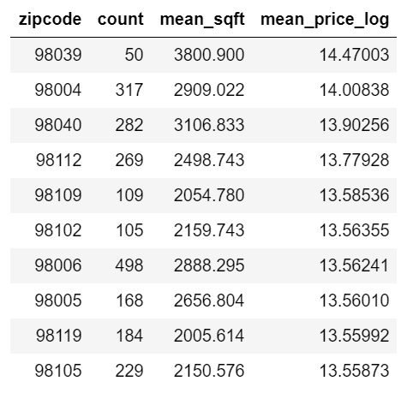
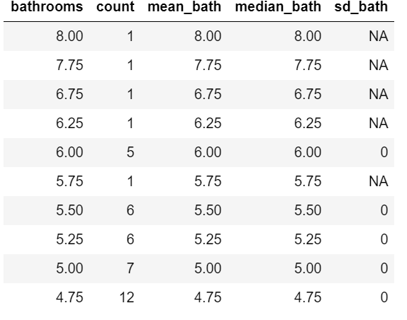
King County Housing Data Central Tendencies for Expensive Locations
Sqft_living area of most expensive zip codes
Bathrooms in most expensive zip codes
Bedrooms in most expensive zip codes

Slide 14
Range of Bed rooms, Bathrooms and Sqft_living
Bed rooms: 4
Bath rooms : 4.76 to 6
Square feet living : 2400 to 3100

Slide 15
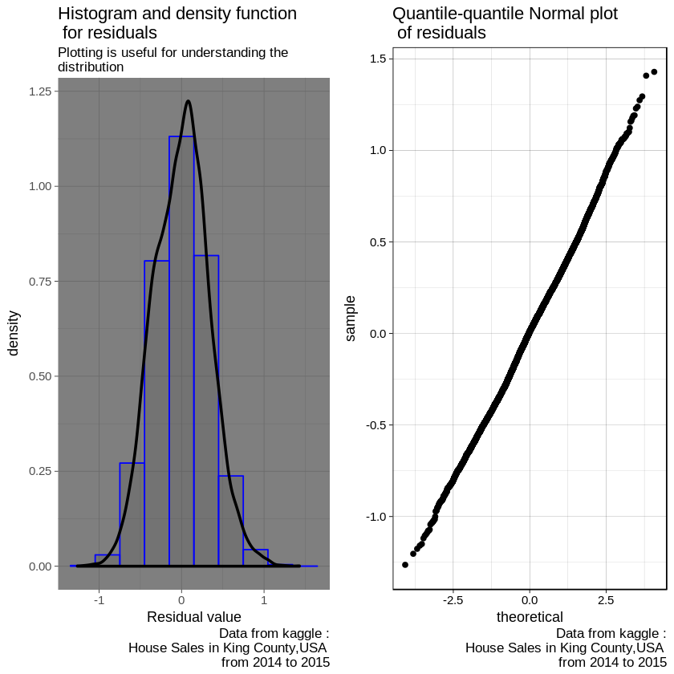
King County Data Multiple Regression Model
house_scaled.mod = lm(price_log ~ bedrooms + sqft_living +floors + waterfront + view + condition + grade + sqftabove , data = house_scaled)
Resids = Actual Value – Score value
R squared | Residual Error | Standard Error | Estimate vale | P -value
0.59 | 0.3349 | 0.002273 | 13.0478 | <2.2e - 16

Slide 16
Single Linear regression model (price ~ sqft_living)
Est Value | St error | P -value
13.047817 | 0.002575 | <2e-16
0.366225 | 0.002575 | <2e-16
Residual error | R square | P-value
0.3785 | 0.4835 | < 2.2e-16
Single Linear regression model (price ~ bedrooms)
Est Value | St error | P -value
13.047817 | 0.003365 | <2e-16
0.180948 | 0.003365 | <2e-16
Residual erro | R square | P -value
0.4946 | 0.118 | < 2.2e-16
T test
 | T value | P value | Mean of x | Mean of Y
Sqft_living | 4.3737 | 0.0005879 | 2623.131 | 1796.131
Bedrooms | 2.5345 | 0.01254 | 3.639847 | 3.344046

Slide 17
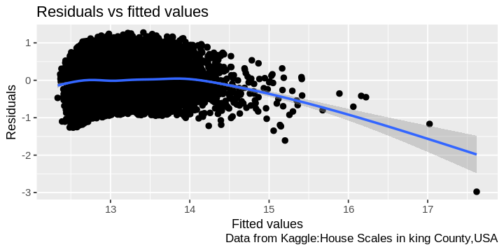
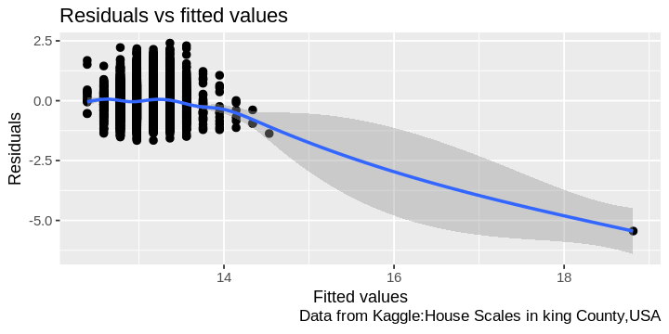
Sqft_living
Bedrooms

Slide 18
King County Housing Data
Conclusion
This Project conduct two experiment for feature selection by using multiple regression and t test. We used 12 features as input to predict price value And concluded that sqft_living and bedrooms are most significant features to increase the house prices
In t test we reject null hypothesis and accept alternative hypothesis for sqft_living feature.

Slide 19
King County Housing Data
Thank You

